Slide 1
Smart Phone Ecosystem

Slide 2

Problem Statement
As global and cross-enterprise collaborations in smartphone manufacturing become more common, the challenge lies in managing the complexities of coordinating multiple stakeholders across different countries and organizations. This can lead to inefficiencies, delays, and higher production costs, ultimately impacting product quality and profitability.

Slide 3
Solution
Implement a streamlined supply chain and communication system through a centralized platform that integrates all stakeholders, including producers, suppliers, manufacturers, and logistics providers. This platform should enable real-time tracking, inventory management, and coordination, reducing delays and costs while improving efficiency and product quality.

Slide 4
UML Class Diagram

Slide 5
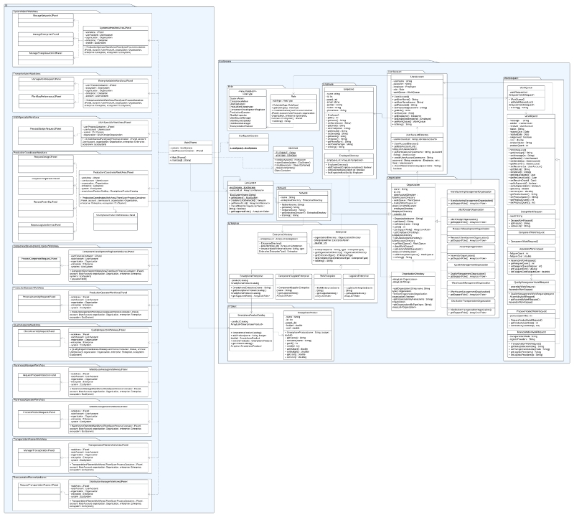

Slide 6
Advanced Feature

Slide 7
Implementing Email Login in the System
User Registration:
Users provide their email, create a password, and complete a verification process.
Verification emails are sent to confirm ownership of the email address.
User Login:
Enter email and password in the login form.
Credentials are authenticated against the database or authentication provider.
Forgot Password:
Provides an option to reset the password via email.
Password reset links are sent to the registered email address.

